Slide 1
Digital Media Technology Week 3: The Tei Header

Slide 2
Ontologies
Models are based on an ontology
Ontologies describe the properties of the original which are represented in the model
A DTD can be viewed as an ontology

Slide 3
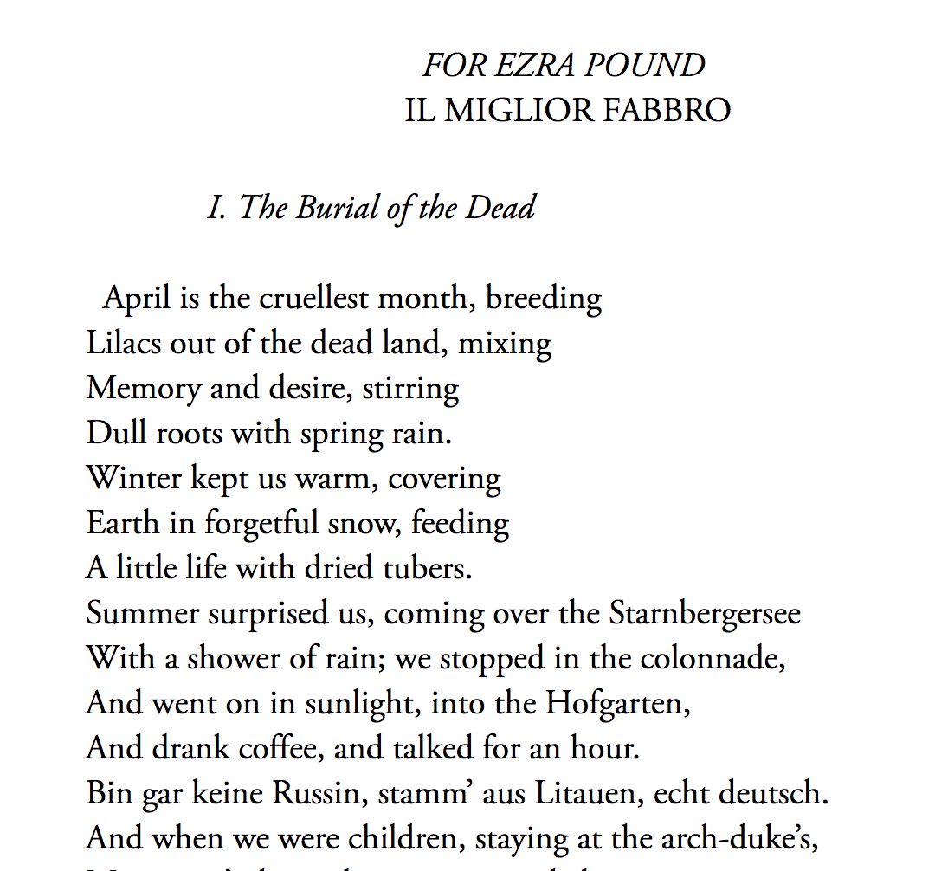
Deconstruction
Logical structure: division into chapters, sections paragraphs
Physical structure: division into quires, pages
Literary devices
Typography: font type, font family, indentation

Slide 4
Presentational markup
<p><b> The Waste Land </b> <br/> BY BY T. S. ELIOT</p>
<p align=“right”> FOR EZRA POUND <br/> <i>IL MIGLIOR FABBRO </i> </p>
<p><i> I. The Burial of the Dead </i></p>
<p> April is the cruellest month, breeding <br/> Lilacs out of the dead land, mixing <br/>
Memory and desire, stirring <br/>
Dull roots with spring rain.
</p>

Slide 5
Descriptive markup
<title> The Waste Land </title> BY <persName> T. S. ELIOT</persName>
<epigraph> FOR EZRA POUND <foreign> IL MIGLIOR FABBRO</foreign> </epigraph>
<div><head> I. The Burial of the Dead </head>
<lg><line> April is the cruellest month, breeding</line> <line>Lilacs out of the dead land, mixing</line> <line>Memory and desire, stirring</line> </lg>

Slide 6
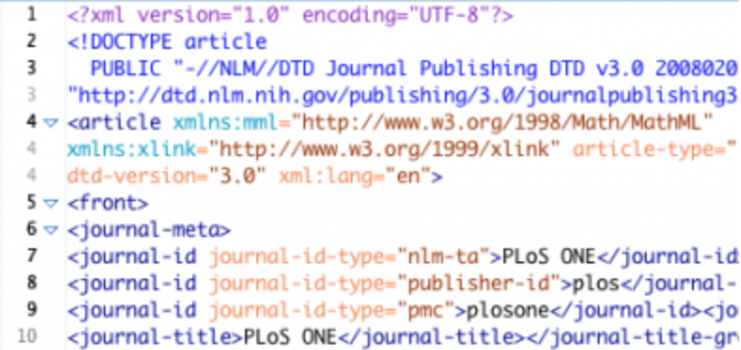

XML is widely used within the publishing industry
Journal Article Tag Suite (JATS)

Slide 7
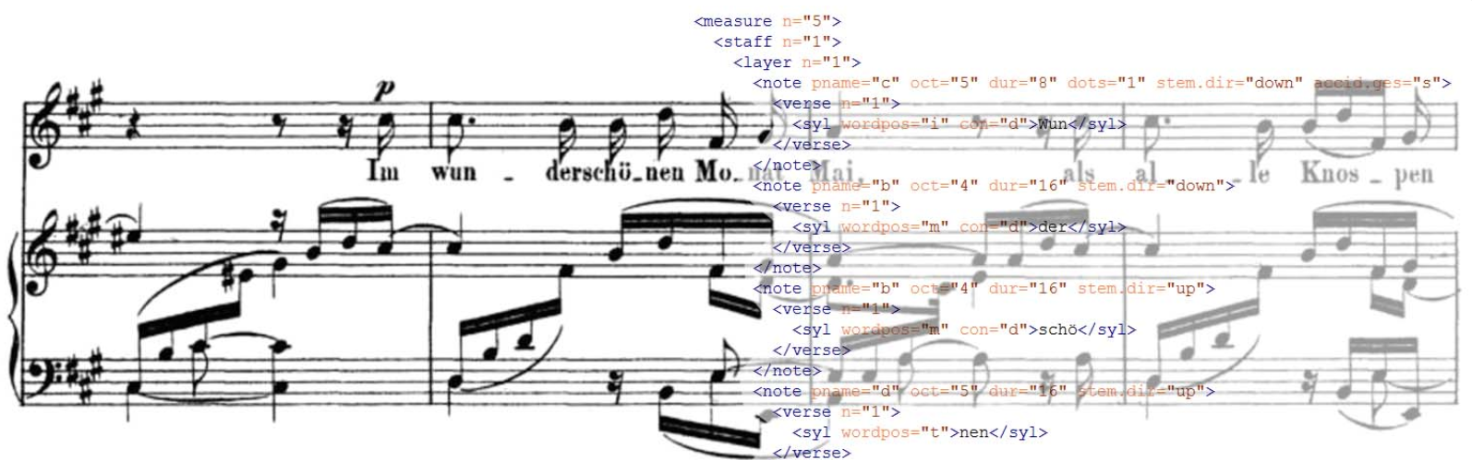
It is also used in many other contexts, e.g. research in musicology
Music Encoding Initiative (MEI)

Slide 8
Text Encoding Initiative
Support for texts of any type, in any genre, from any period
De facto standard for digital scholarly editions

Slide 9
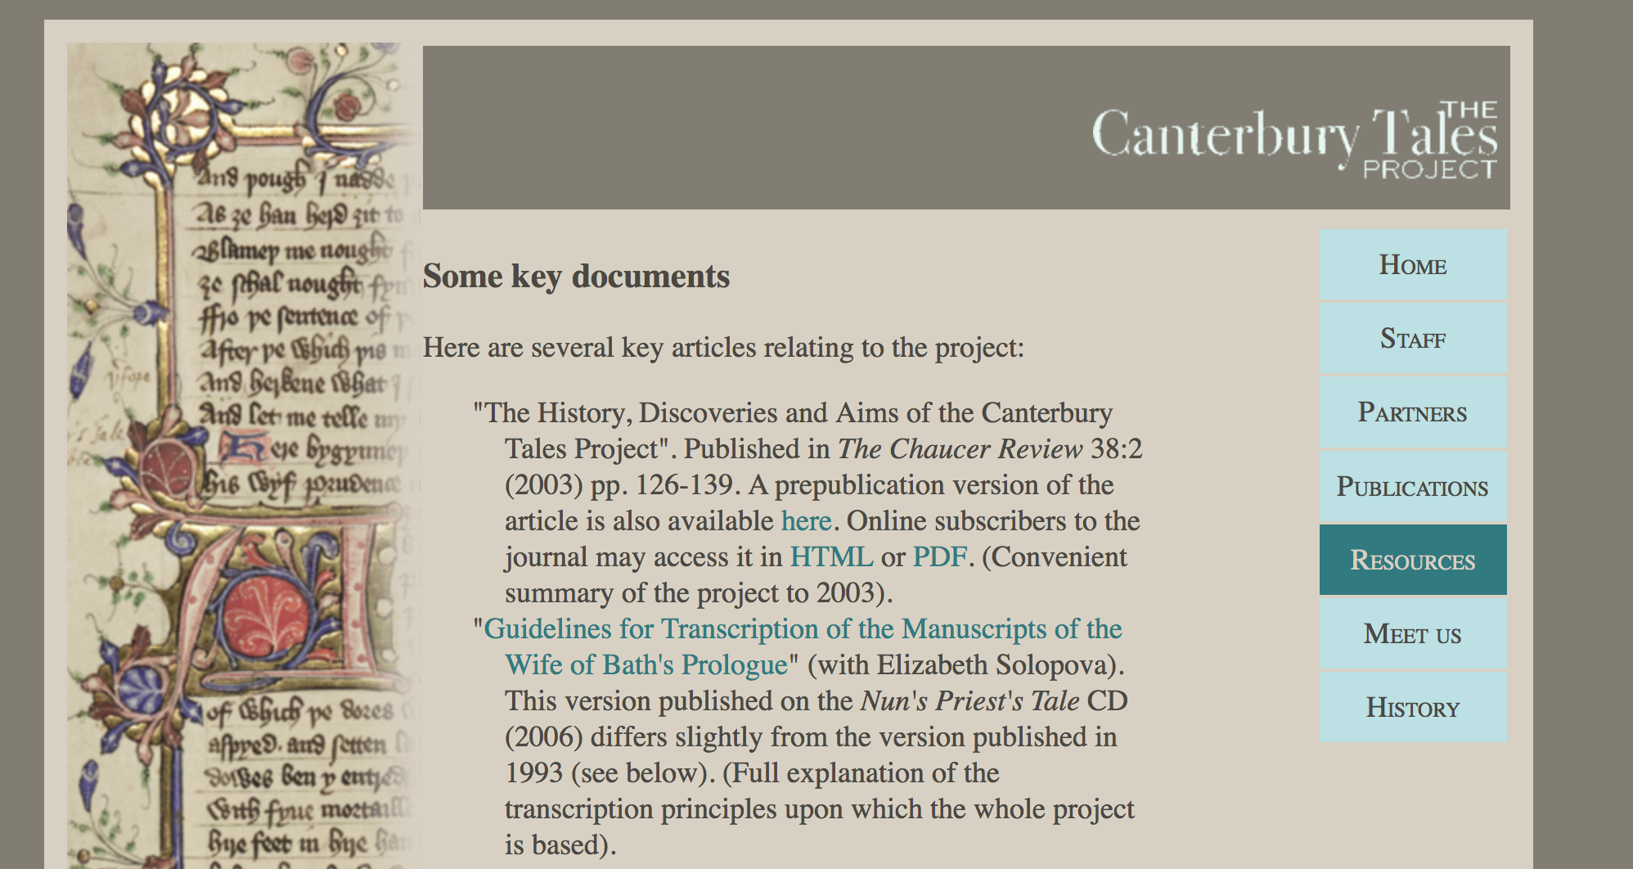
Canterbury Tales (Peter Robinson)

Slide 10
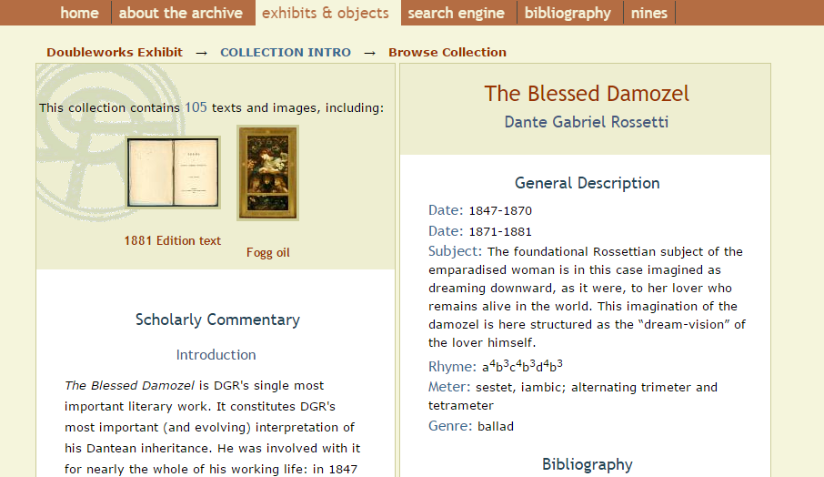
The Rossetti Archive (Jerome mcGann)

Slide 11
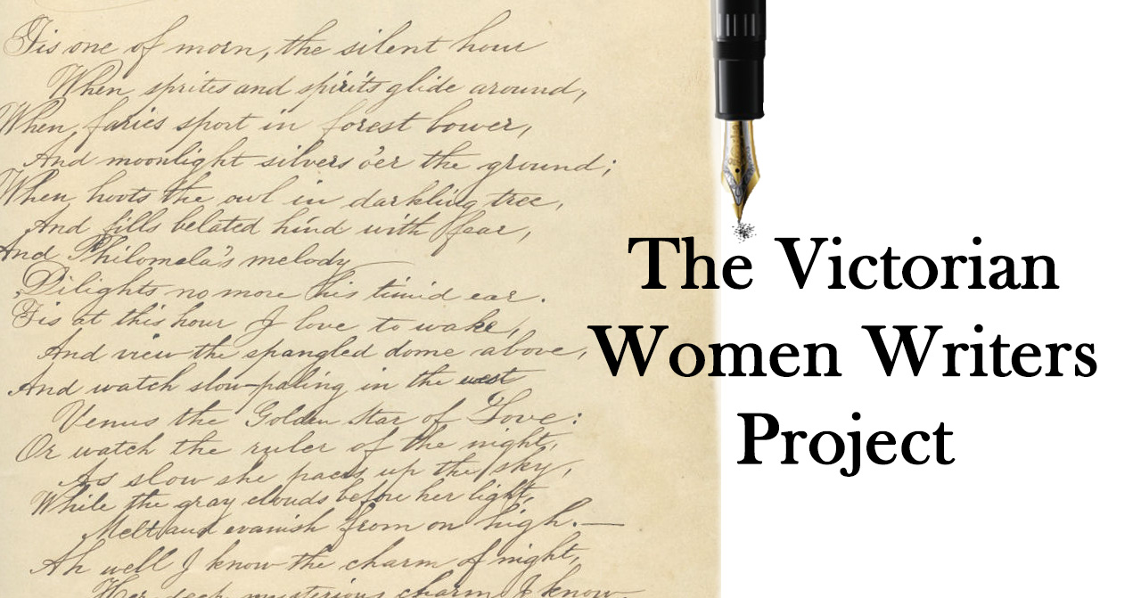
Women Writers Project (Julia Flanders)

Slide 12
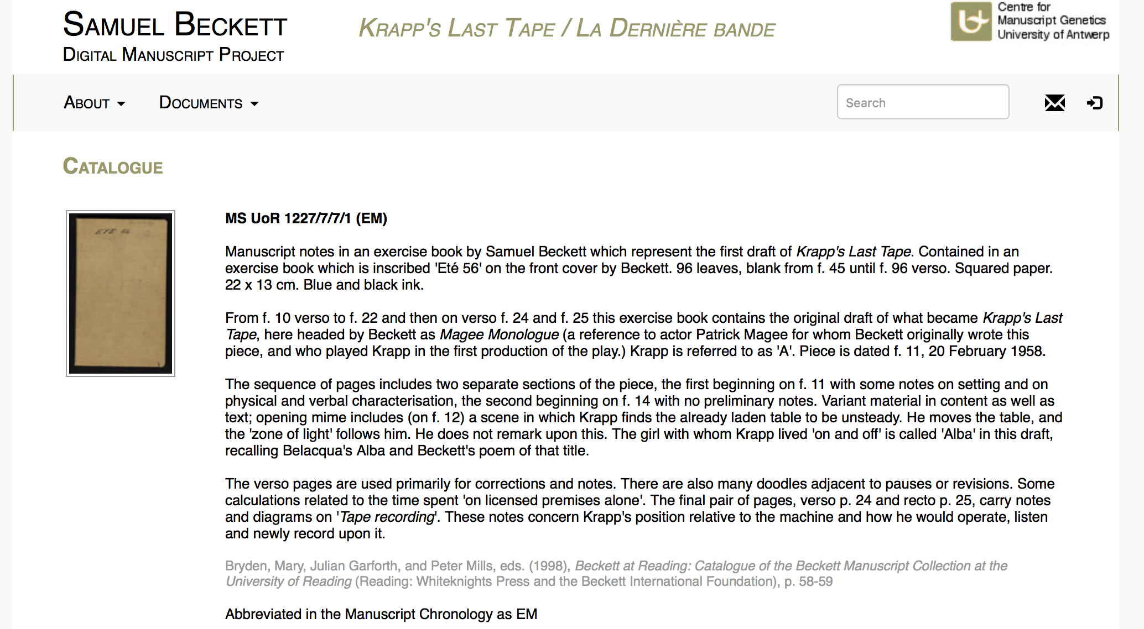
Samuel Becket Archive (Dirk Van Hulle)

Slide 13
TEI
teiHeader
text
Information about the transcription
The transcription itself

Slide 14
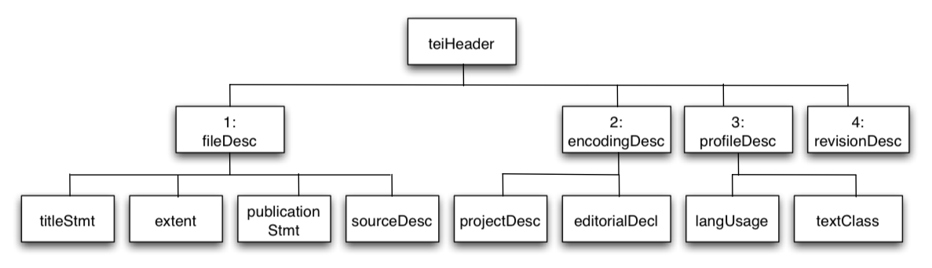
fileDesc
titleStmt
extent
publicationStmt
sourceDesc
encodingDesc
projectDesc
profileDesc
langUsage
textClass

Slide 15
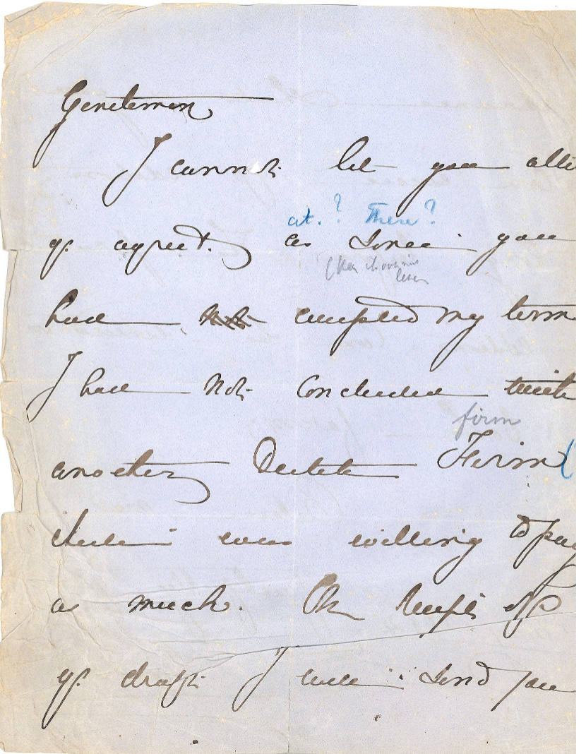
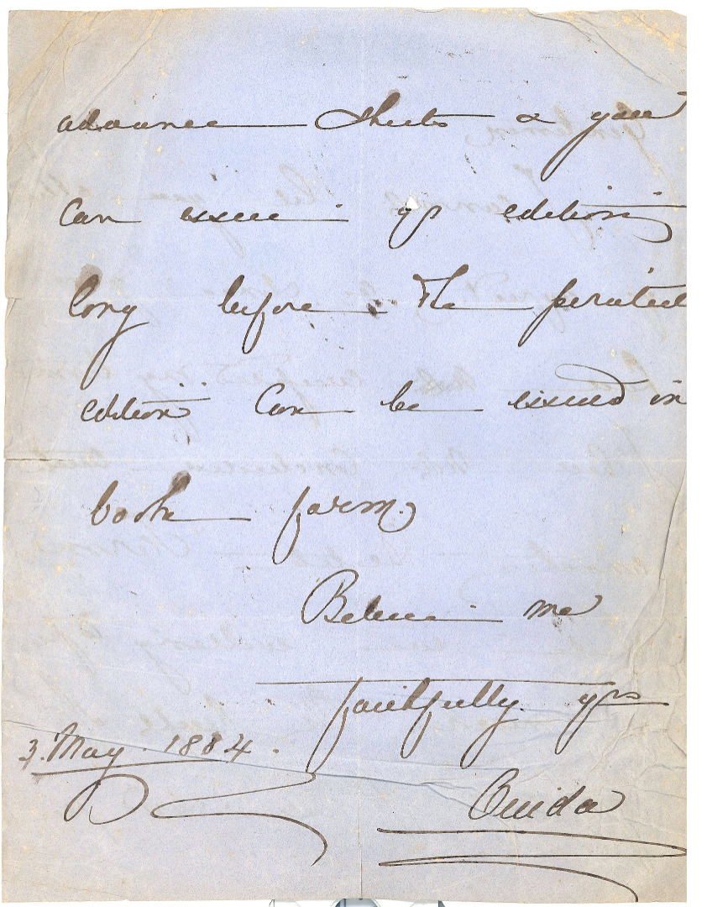
Metadata in the TeiHeader provide explicit and structured information about date of creation, language, place of creation, the sender, the recipient, etc.

Slide 16
Metadata
“Data about data”
Surrogates for the real thing, cf. a map and the territory that it maps
Created for a purpose (using, retrieving, managing resources)
Structured information
Growing number of metadata formats, e.g. MARC21, EAD, Dublin Core, METS, ONYX

Slide 17
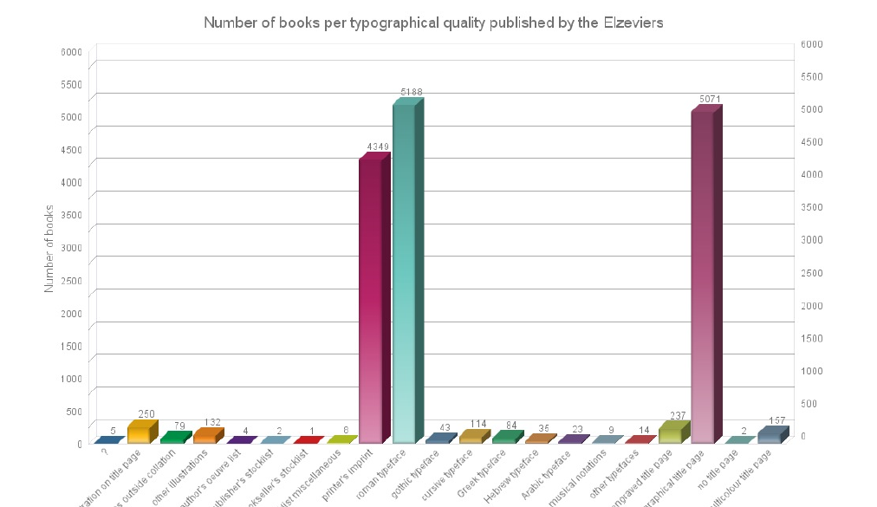
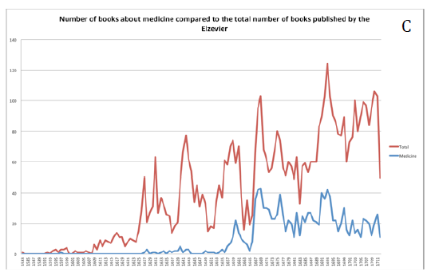
Metadata as research data

Slide 18
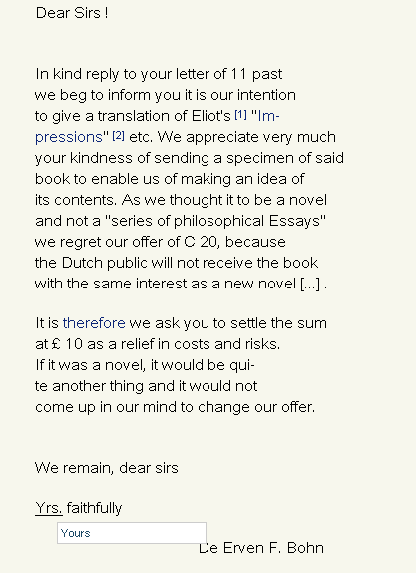
<choice> <orig>Impressions</orig> <reg>Impressions of Theophrastus Such</reg> </choice>
<choice> <abbr>Yrs.</abbr> <expan>Yours</expan> </choice>

Slide 19
We will sent you a first instalment of the proofs of the story on the 25th of April.
<choice> <sic>sent</sic> <corr>send</corr> </choice>
<date when="1895-04-25">25th of April</date>

Slide 20
Uses of text encoding
“Intelligent texts”: Searching beyond free text searches
Different types of editions, based on a single source file
Presentation of the same contents in different typography

Slide 21
Medium-neutrality (or single source publishing)
HTML
PDF
TEI
Stylesheet
MS Word
ePUB

Slide 22
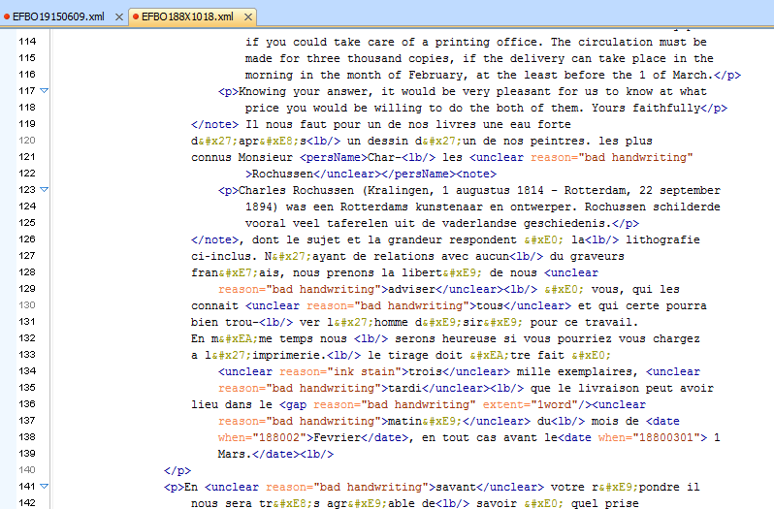
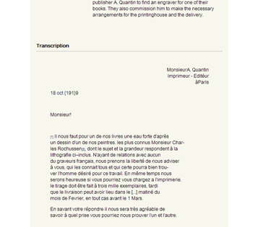
Stylesheet

Slide 23
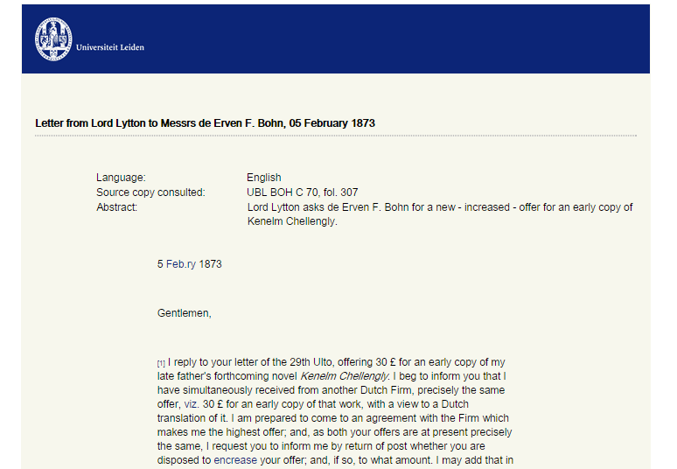
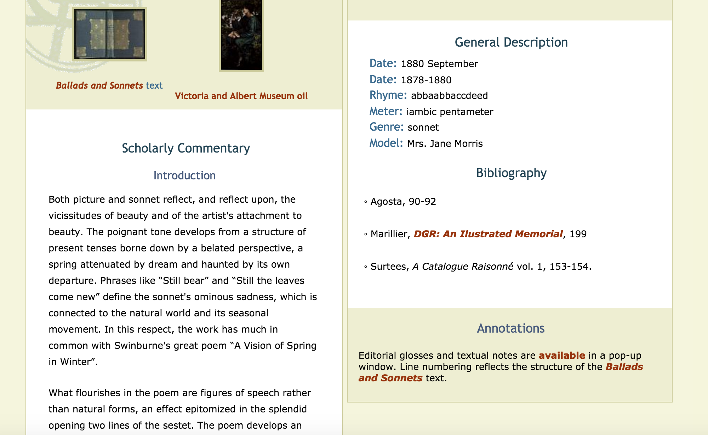
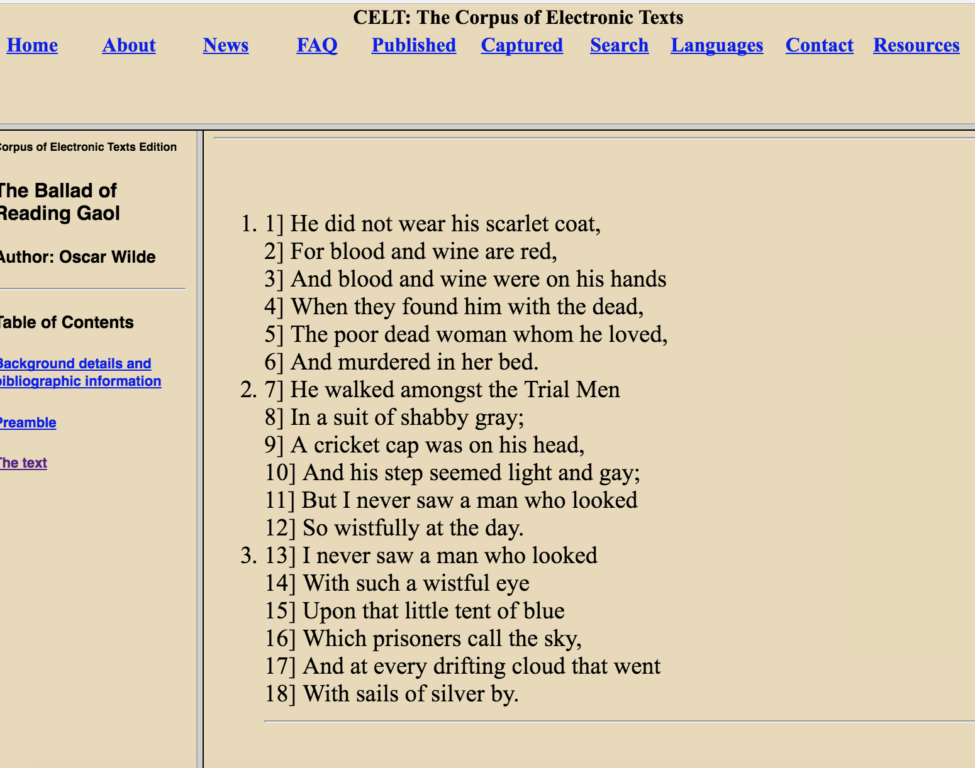

Slide 24
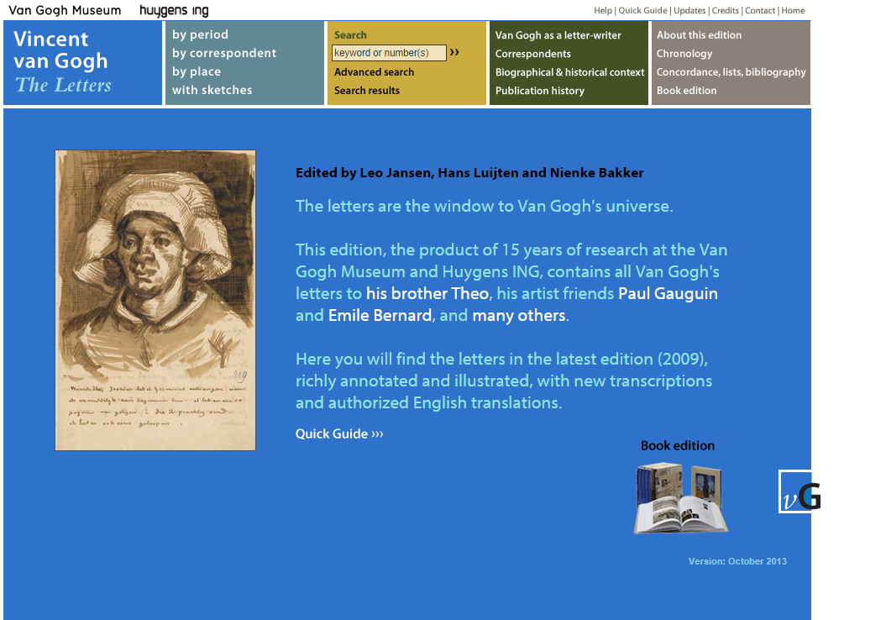
Vincent Van Gogh Letters

Slide 25
XML and presentation
Descriptive markup vs. presentational markup (cf. COTM, p. 19)
TEI encoding is a form of descriptive markup: it mainly describes the intellectual or semantic contents (e.g. book titles, personal names, dates) and the logical structure
Form is flexible; it is added at a later stage, via a stylesheet

Slide 26
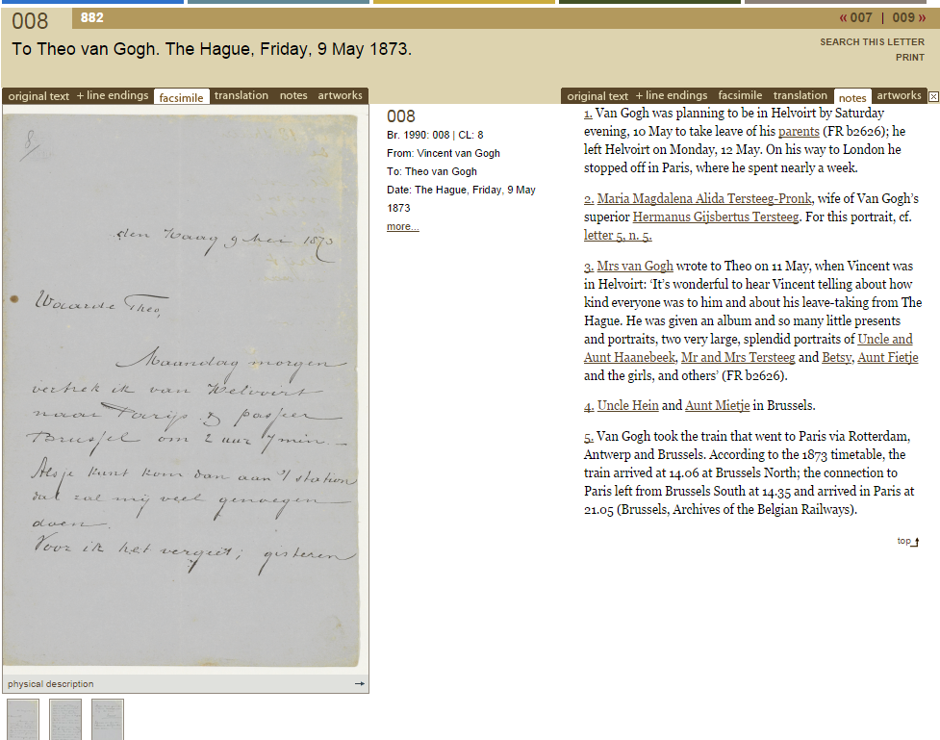
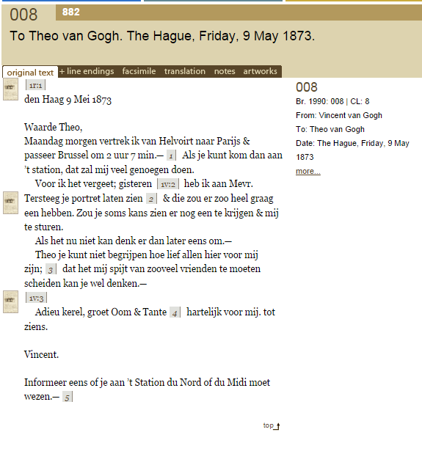
Vincent Van Gogh Letters

Slide 27
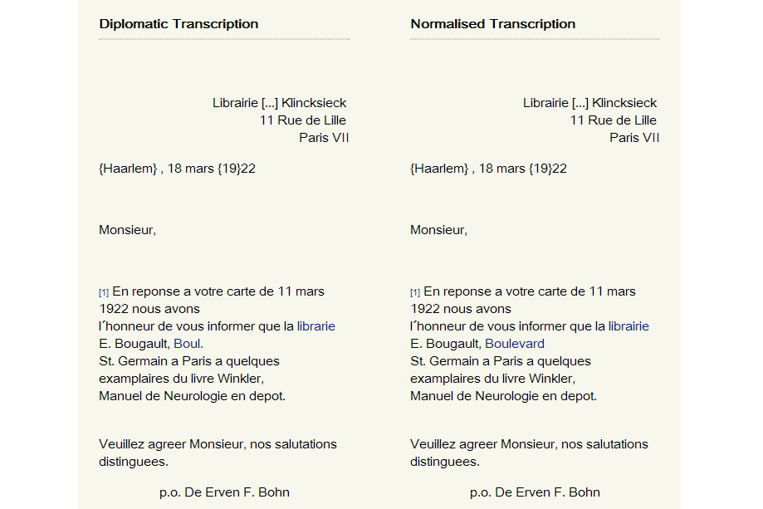
Diplomatic and normalised edition may be produced from a single source

